Slide 1
{Clio}: Clean and Simple Historical Statistics
Jill Levine (BA, MA)
Project Manager and Researcher, Seshat: Global History Databank
@jdlevine github/jlevine23

Slide 2
@jdlevine
Project Coordinator @SeshatDatabank
History MA
Project Manager/Researcher @SeshatDatabank
Starting learning R
Data Manager @SeshatDatabank
Left this month to work for the Stó:lō Nation…interested in applying R to a more policy-focused role.
Notes:
My name is Jill Levine, based in Victoria, and I worked for the past six years at a project called Seshat Global History Databank with a team that built, collected, and analyzed historical datasets.
I’ve spent most of my career working with historical data.

Slide 3
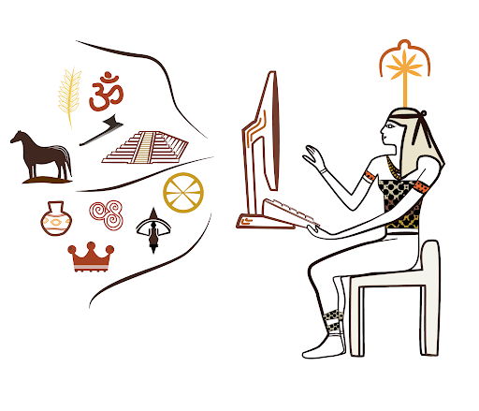
Notes:
The goal of Seshat Databank is to collect and build datasets on human history, archaeology and anthropology from secondary sources. Basically, we want to capture all the knowledge that has already been recorded by experts.
Recently we’ve been playing more with the semi-automatic integration of open-source datasets that are available online into our databank.
Part of my work involves pulling large historical datasets and cleaning them- basically my professor bosses come to me and say Jill- we need all the premodern data we can find on xyz topic.

Slide 4
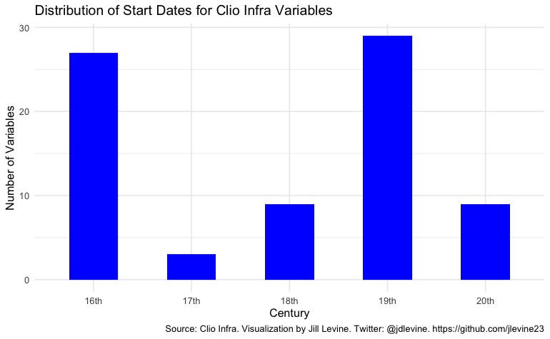
Notes:
One of the datasets I’ve worked with recently is Clio Infra. Clio Infra is a really large historical data store, with a huge range of data from number of cattle per capita to number of libraries to number of conflicts etc. It covers the globe and goes back to 1500 in some regions.

Slide 5

Notes:
When my boss asked me to pull all related data from Clio Infra- I was like cool, these are individual downloads, this will take the rest of my life.

Slide 6
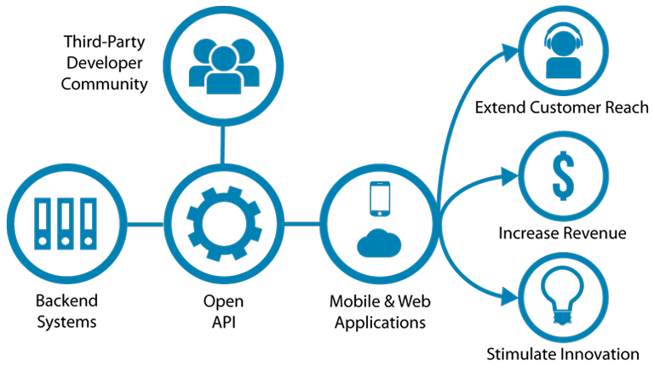
Notes:
Luckily, a PhD student named Bas Michelson developed a really good R package that interacts with the Clio Infra API. These kind packages of let you pull big datasets a lot faster and in a more systemized way
Datasets like Gapminder, World Bank, have similar APIs but I found this one to be one of the better ones, especially for beginner R users like myself.

Slide 7
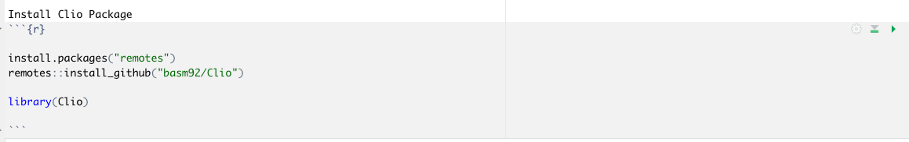
Notes:
Because it is still under development it can be installed as a remote package.
After installing it’s pretty easy to call up data:
You can also browse the Clio Infra library by category [image] or by variable [image]
Lets you easily pull large datasets from Clio Infra by category or variable
or country name or within a specific date range. [example]

Slide 8
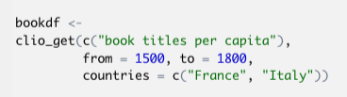
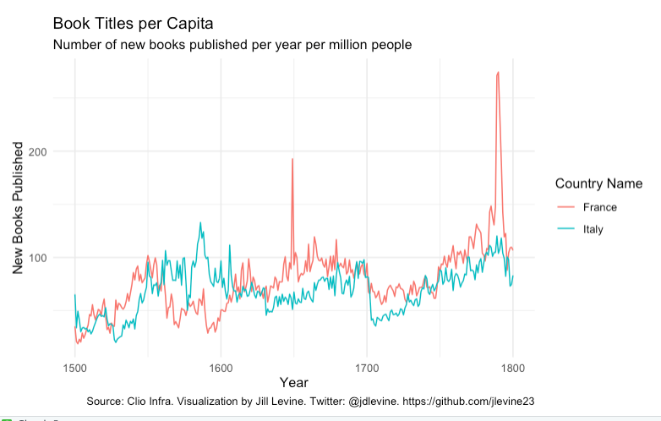
Notes:
This data has lots of cool possibilities:
Compare two variables within a country (viz)

Slide 9
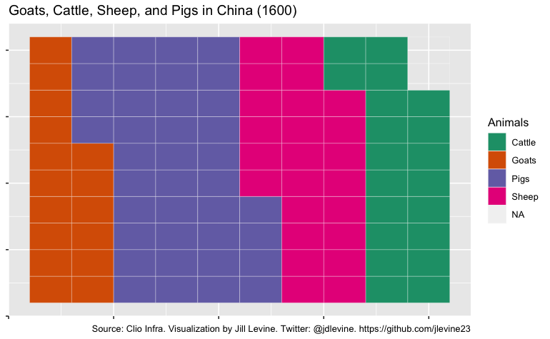

Slide 10
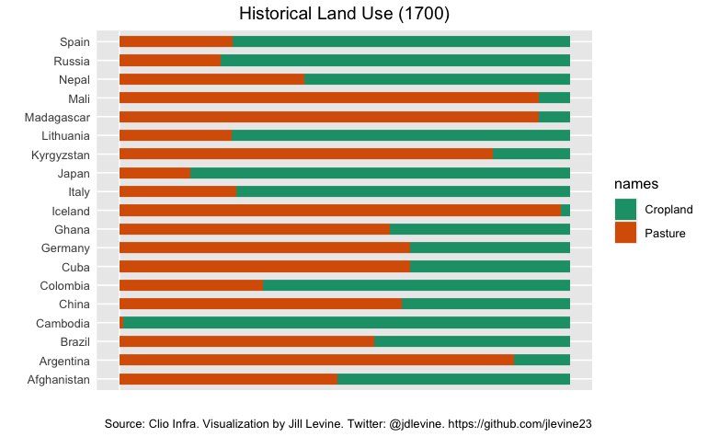
Notes:
Compare different countries

Slide 11
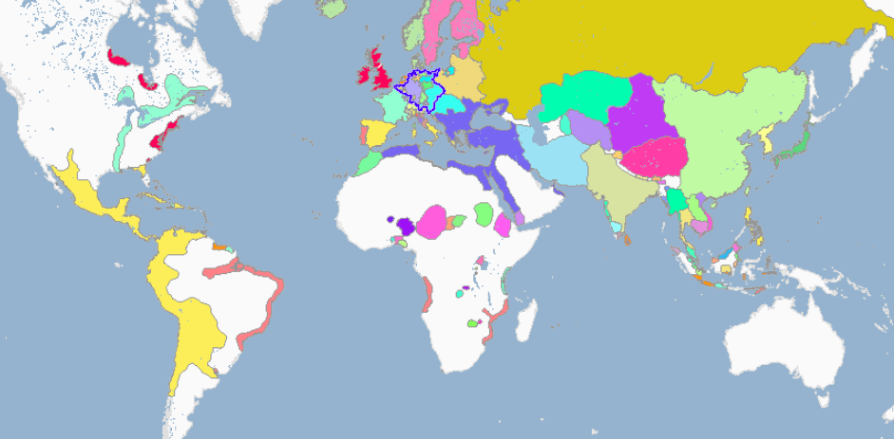
Source: Geachron
Notes:
The downsides are- you can’t pull everything-
Data is Western centric
Countries didn’t always exist in this period- either through modeling or within a historical data now known as that country

Slide 12
Thank You!
The R code for these visualizations is available at github/jlevine23
@jdlevine

